Slide 1

SCHOOL OF COMPUTER SCIENCE AND ENGINEERING
SOFTWARE ENGINEERING (SE)
(CSE1005)
Module No-1 : An Overview of Software Engineering
Jainabbi.banda
Assistant Professor @ SCOPE

Slide 2
Course Objectives:
To teach the concepts of the software process, product, and project
To elucidate the knowledge of requirement analysis
To provide knowledge of software design and testing
To introduce the project management techniques and asses the risk management

Slide 3
SOFTWARE ENGINEERING DEFINITIONS
IEEE defines software engineering as:
(1) The application of a systematic, disciplined, quantifiable approach to the development, operation and maintenance of software; that is, the application of engineering to software.
(2) The study of approaches as in the above statement.

Slide 4
What is Software Engineering?
The term software engineering is the product of two words, software, and engineering.
The software is a collection of integrated programs.
Software subsists of carefully-organized instructions and code written by developers on any of various particular computer languages.
Computer programs and related documentation such as requirements, design models and user manuals.
Engineering is the application of scientific and practical knowledge to invent, design, build, maintain, and improve frameworks, processes, etc.
Software Engineering is an engineering branch related to the evolution of software product using well-defined scientific principles, techniques, and procedures. The result of software engineering is an effective and reliable software product.

Slide 5
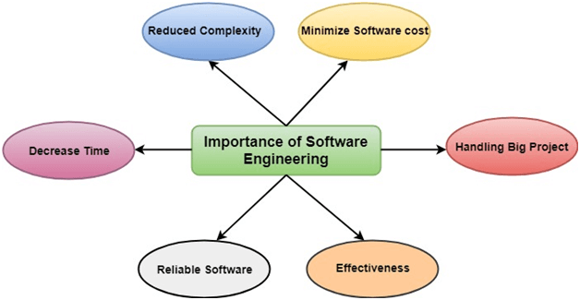
IMPORTANCE OF SOFTWARE ENGINEERING

Slide 6
Principles of Software Engineering
Manage using a phased life-cycle plan.
Perform continuous validation.
Maintain disciplined product control.
Use modern programming practices.
Maintain clear accountability for results.
Use better and fewer people.
Maintain a commitment to improve the process.

Slide 7
Module No.1 : An Overview of Software Engineering
Nature of Software
Software Engineering
Software Process
Software Engineering Practice,

Slide 8
NATURE OF SOFTWARE
Software is:
instructions (computer programs) that when executed provide desired features, function, and performance;
(2) data structures that enable the programs
to adequately manipulate information, and
(3) document that describes the operation
and use of the programs.

Slide 9
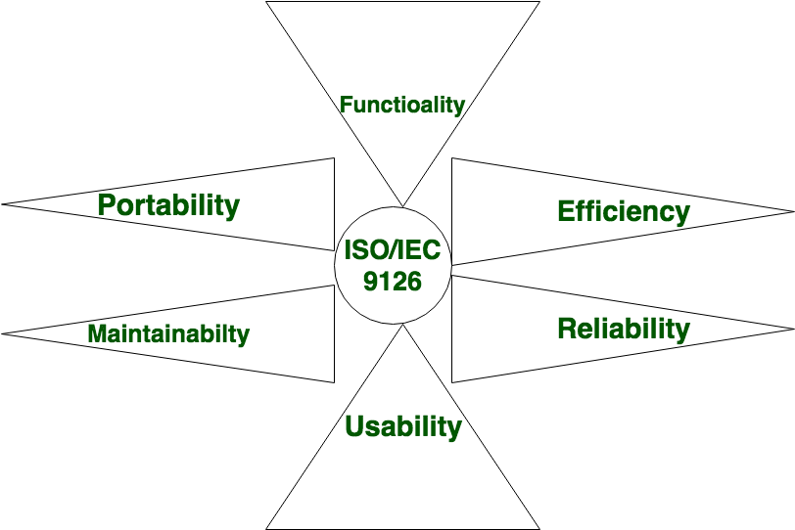
Characteristics of Software

Slide 10
THE CHANGING NATURE OF SOFTWARE
Seven Broad Categories of software are challenges for software engineers
System software: System software is a collection of programs written to service other programs. System software: such as compilers, editors, file management utilities.
Application software: stand-alone programs for specific needs. This software are used to controls business needs. Ex: Transaction processing.

Slide 11
Embedded software – This software resides within a system or product and it is used to implement and control features and functions from end user and system itself. This software performs limited function like keypad control for microwave oven.
Artificial intelligence software - Artificial intelligence (AI) software makes use of nonnumeric algorithms to solve complex problems. Application within this area include robotics, pattern recognition, game playing.
Engineering and scientific software - Engineering and scientific software have been characterized by "number crunching" algorithm.

Slide 12
Product-line software - focus on a limited marketplace to address mass consumer market. (word processing, graphics, database management) .
WebApps (Web applications) network centric software. As web 2.0 emerges, more sophisticated computing environments is supported integrated with remote database and business applications.

Slide 13
LEGACY SOFTWARE
Legacy software are older programs that are developed decades ago.
The quality of legacy software is poor because it has inextensible design, convoluted code, poor and nonexistent documentation, test cases and results that are not achieved.
As time passes legacy systems evolve due to following reasons:
The software must be adapted to meet the needs of new computing environment or technology.
The software must be enhanced to implement new business requirements.
The software must be extended to make it interoperable with more modern systems or database
The software must be rearchitected to make it viable within a network environment.

Slide 14
SOFTWARE ENGINEERING
[Software engineering is] the establishment and use of sound engineering principles in order to obtain economically software that is reliable and works efficiently on real machines.
or
◼ The IEEE definition:
Software Engineering: (1) The application of a systematic, disciplined, quantifiable approach to the development, operation, and maintenance of software; that is, the application of engineering to software.

Slide 15
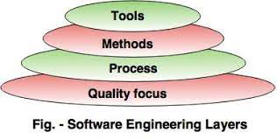
Software Engineering - layered technology
Software engineering is a fully layered technology.
• To develop a software, we need to go from one layer
to another.
• All these layers are related to each other and each
layer demands the fulfillment of the previous layer

Slide 16
1. Quality focus
The characteristics of good quality software are:
• Correctness of the functions required to be performed by the software.
• Integrity i.e. providing security so that the unauthorized user cannot access information or data.
• Usability i.e. the efforts required to use or operate the software.
2. Process
• It is the base layer or foundation layer for the software engineering. It covers all activities, actions and tasks required to be carried out for software development.
3. Methods
• It provides the technical way to implement the software. It includes collection of tasks starting from communication, requirement analysis, analysis and design modelling, program construction, testing and support.
4. Tools-The software engineering tool is an automated support for the software development. The tools are integrated i.e the information created by one tool can be used by the other tool.

Slide 17
THE SOFTWARE PROCESS
A process is a collection of activities, actions, and tasks that are performed when some work product is to be created.
An activity strives to achieve a broad objective with which software engineering is to be applied. An action encompasses a set of tasks that produce a major work .
A task focuses on a small, but well-defined objective that produces a tangible outcome.
A generic process framework for software engineering encompasses five activities:

Slide 18
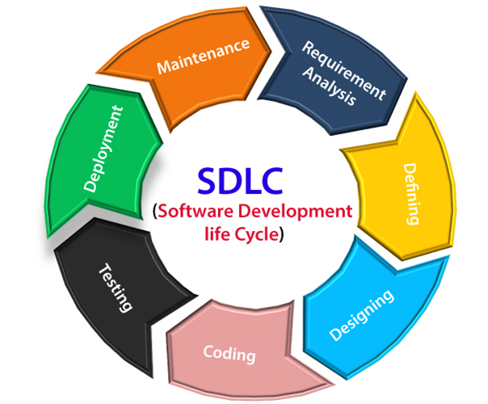
SDLC
Software development life cycle (SDLC) is a structured process that is used to design, develop, and test good-quality software.
SDLC, or software development life cycle, is a methodology that defines the entire procedure of software development step-by-step.

Slide 19
Software engineering process framework activities are complemented by a number of umbrella activities.
In general, umbrella activities are applied throughout a software project and help a software team manage and control progress, quality, change, and risk.
Typical umbrella activities include……

Slide 20
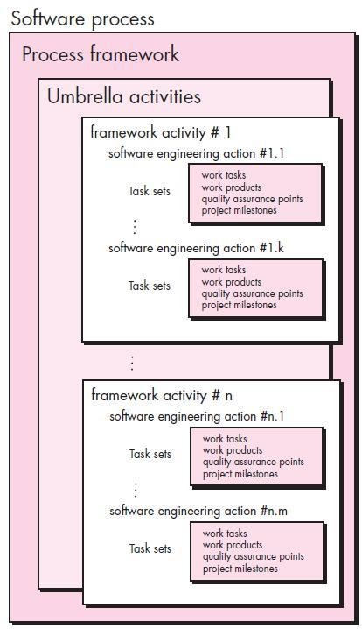
A Generic Process Model
A generic process framework for software engineering defines five framework activities
Communication
Planning
Modeling
Construction
Deployment
In addition, a set of umbrella activities are applied throughout the process.
Project tracking and control
Risk management
Quality assurance
Configuration management,
Technical reviews, and others
20

Slide 21
Typical umbrella activities include…..
Software project tracking and control—allows the software team to assess progress against the project plan and take any necessary action to maintain the schedule.
Risk management—assesses risks that may affect the outcome of the project or the quality of the product.
Software quality assurance—defines and conducts the activities required to ensure software quality.
Technical reviews—assesses software engineering work products in an effort to uncover and remove errors before they are propagated to the next activity.

Slide 22
Typical umbrella activities include…..
Measurement—defines and collects process, project, and product measures that assist the team in delivering software that meets stakeholders’ needs; can be used in conjunction with all other framework and umbrella activities.
Software configuration management—manages the effects of change throughout the software process.
Reusability management—defines criteria for work product reuse (including software components) and establishes mechanisms to achieve reusable components.
Work product preparation and production—encompasses the activities required to create work products such as models, documents, logs, forms, and lists.

Slide 23
SOFTWARE ENGINEERING PRACTICES
The Essence of Practice
1. Understand the problem
2. Plan a solution
3. Carry out the plan
4. Examine the result for accuracy

Slide 24
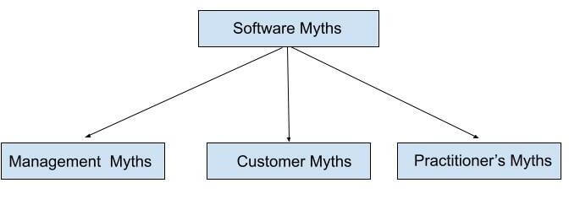
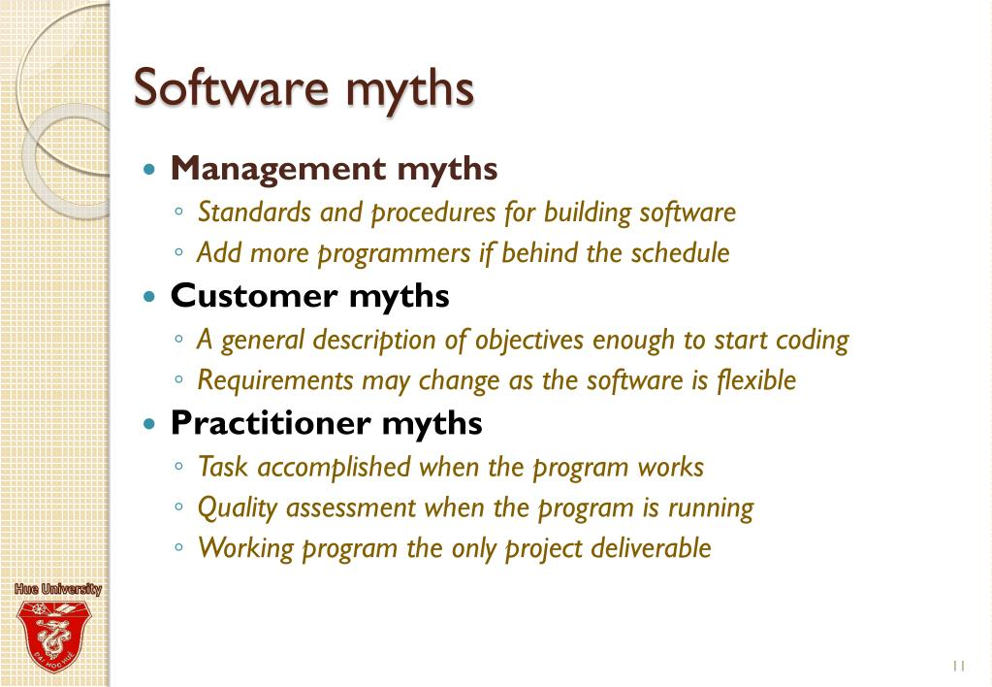

Slide 25
THANK YOU

